Slide 1
Linux Bash

Slide 2
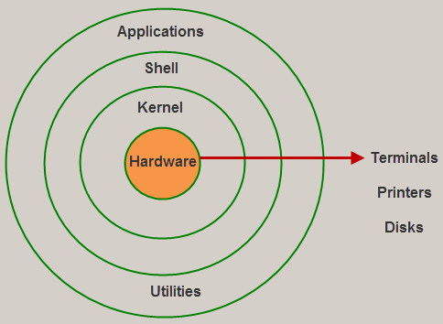
Kernel/Shell

Slide 3
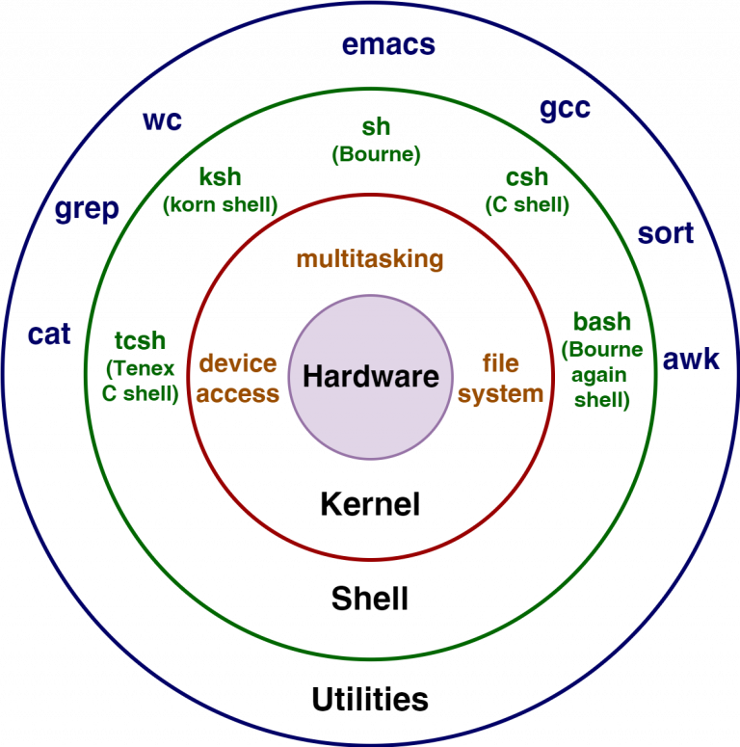
more

Slide 4
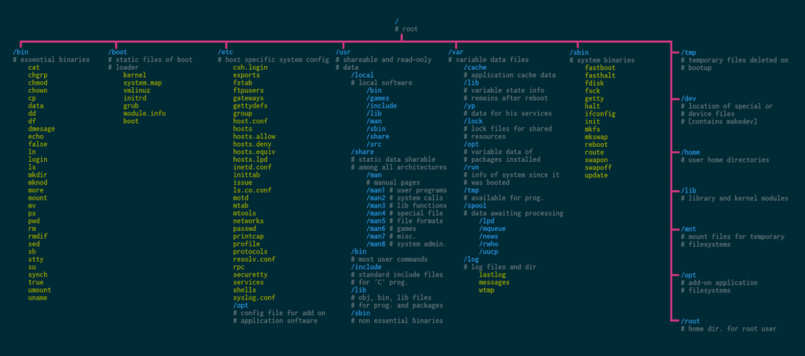

Slide 5
Shell command
command [options] argument
for example: ls -l
Interrupting Programs (Ctrl-c)
How linux locate your command
1. find if it is under currect working dir (pwd)
2. find it under $PATH

Slide 6
File system Navigation
cd ..
cd -
cd ~
pwd
ls
ll
rm
cp
mv

Slide 7
Files
cat
touch
head
tail
vi
vim
hexdump
nano

Slide 8
File content
all binary
Text editor (vi, nano, vim, vim) interprets it as ASCII
Hexdump views it as Hex/Octal/Decimal/ASCII (黑客工具）

Slide 9
File permissions
File type and permissions (e.g., drwxr-xr-x):
- d = Directory
- - = Regular file
- l = Symbolic link
- rwx = User/Group/Others permissions
drwxr-xr-x 5 user group 4096 Jan 10 14:30 Documents/
-rw-r--r-- 1 user group 512 Dec 25 09:15 report.txt
lrwxrwxrwx 1 user group 24 Jan 12 10:00 link -> /path/to/target

Slide 10
Output to Screen ( standard out /dev/stdout)
echo
print
ubuntu@VM-8-9-ubuntu:~$ ls -l /dev/stdout
lrwxrwxrwx 1 root root 15 Mar 22 09:19 /dev/stdout -> /proc/self/fd/1
By understanding /dev/stdout, you can better control and debug process output in Linux

Slide 11
First bash
shebang #1/usr/bin
echo hello world
save, :w
make it executable chmod u+x
using source or . to execute

Slide 12
Bash argument
$1
$2
..
$@
$#

